Slide 1
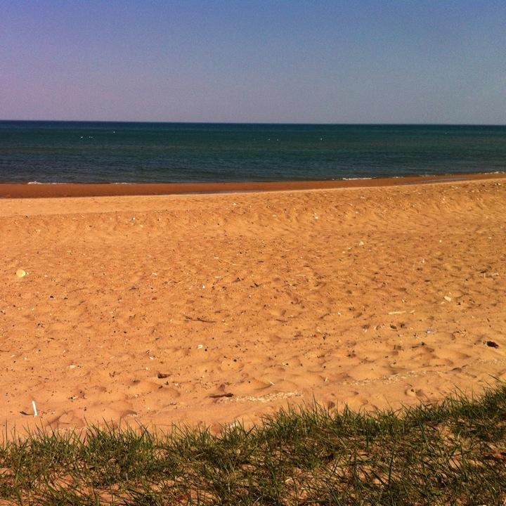

Slide 2
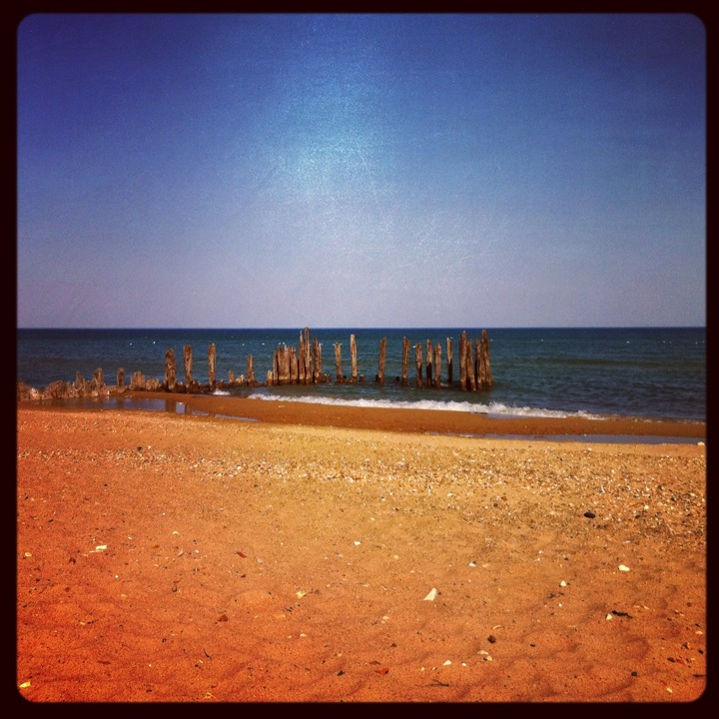
Dear God, are you here?

Slide 3
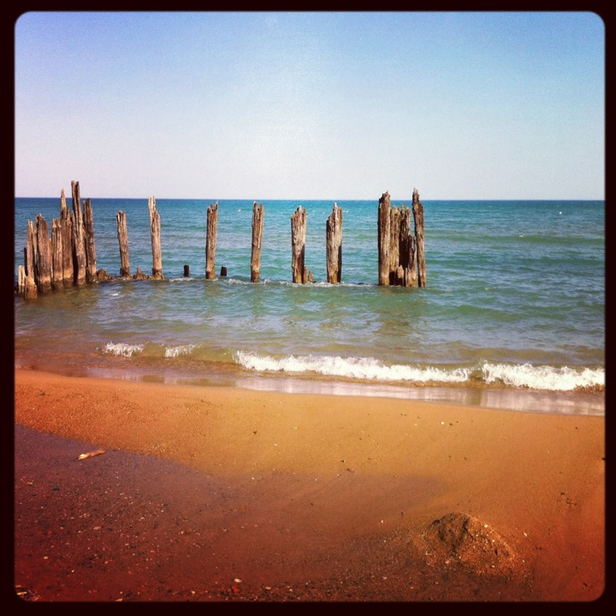
I am listening…

Slide 4
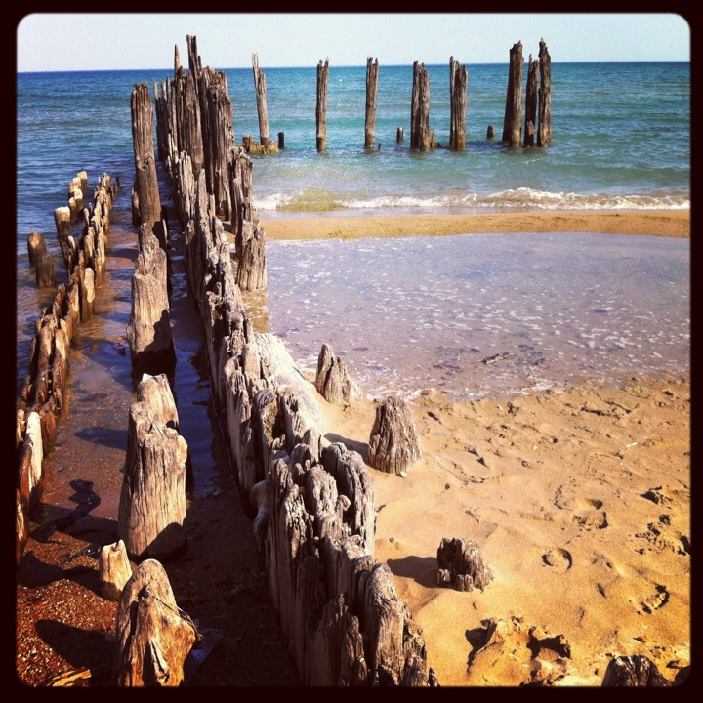
The way does not seem straight.

Slide 5
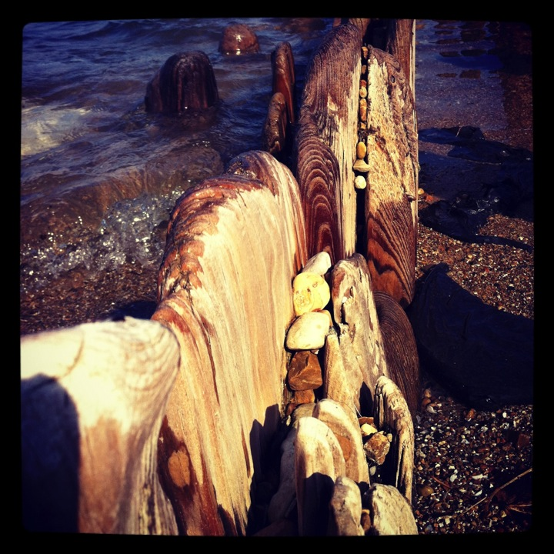
I am worn down
by the waves.

Slide 6
I am trying
to read
the patterns.

Slide 7
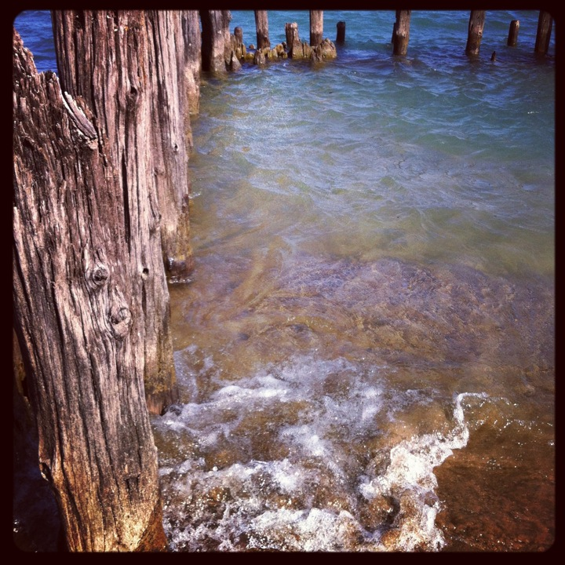
Everything
changes
all the time.

Slide 8
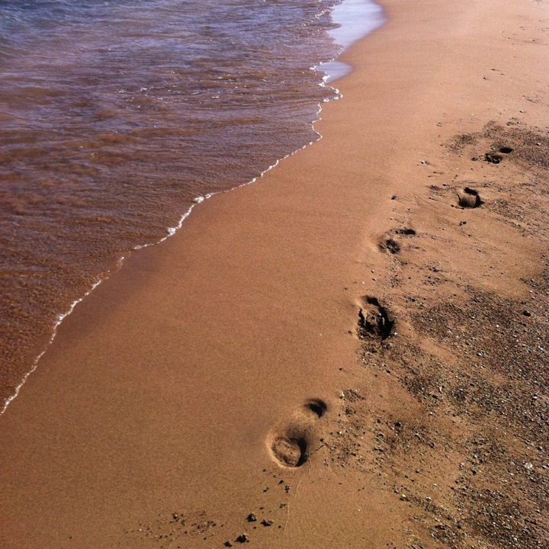
I can’t go back
the same way.

Slide 9
Can’t go back.

Slide 10
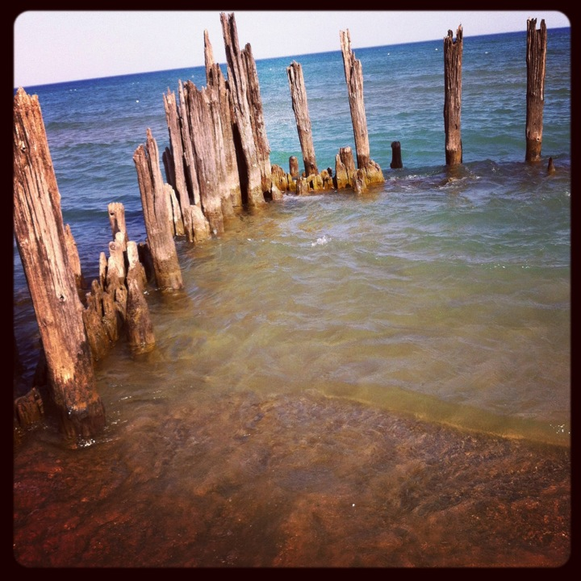

Slide 11
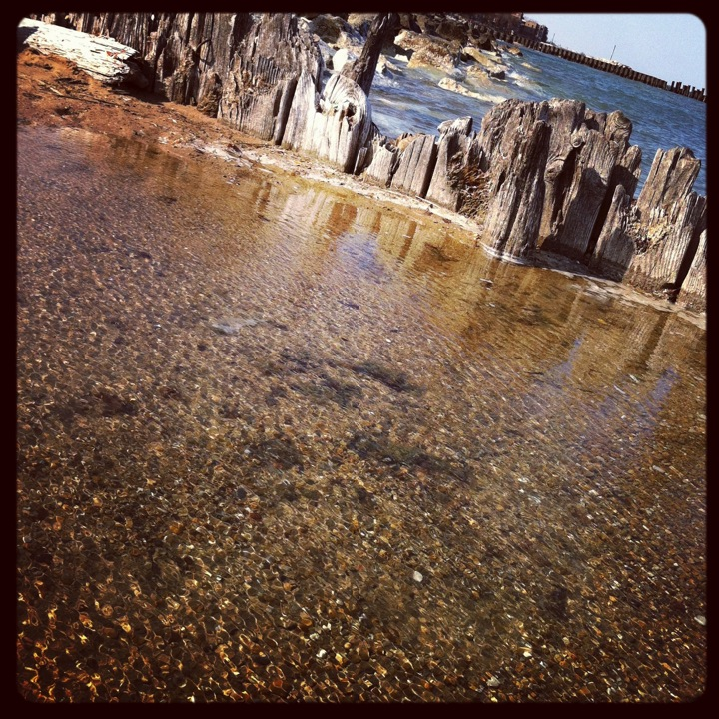
Some of it looks
familiar.

Slide 12
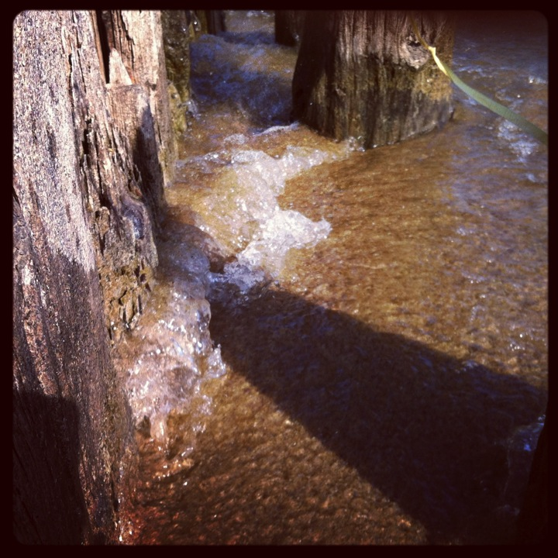
The waters are
rising up to my
neck.

Slide 13
Come to the aid
of your people,
Holy One.

Slide 14
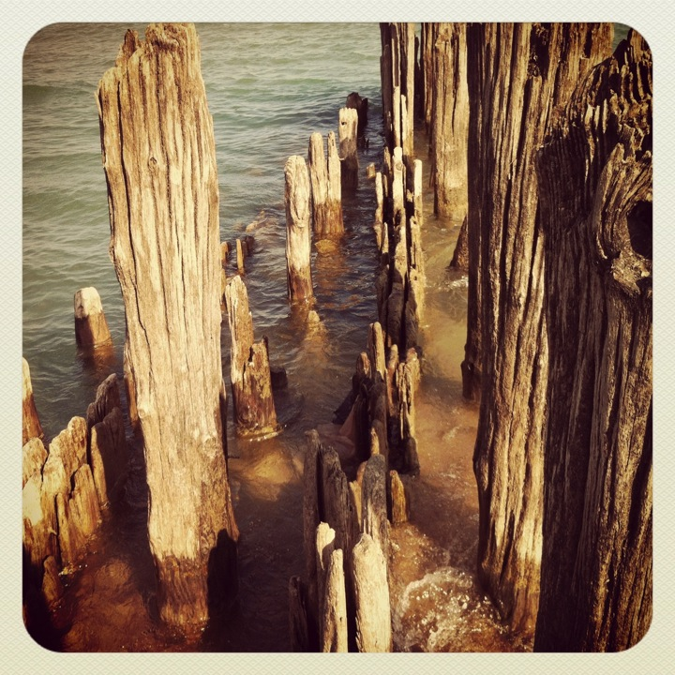
Foundations of old
have passed away.

Slide 15
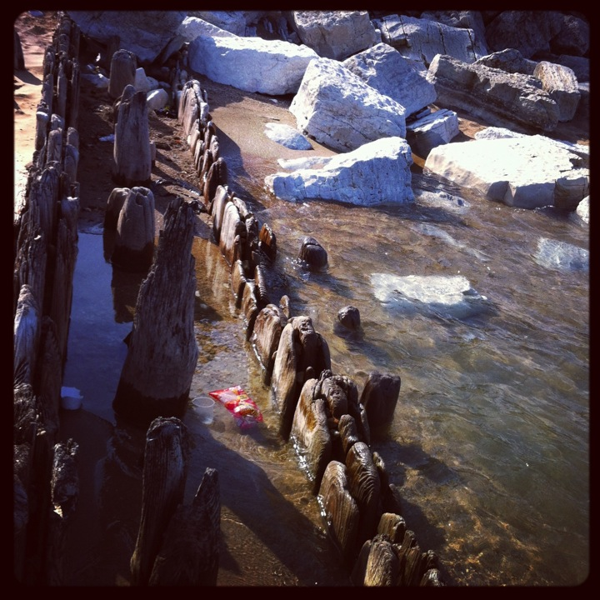
The footing
is uncertain.

Slide 16
Bit
by bit
I have been worn away.

Slide 17
From where does my help come?

Slide 18
Never have you forsaken me.

Slide 19
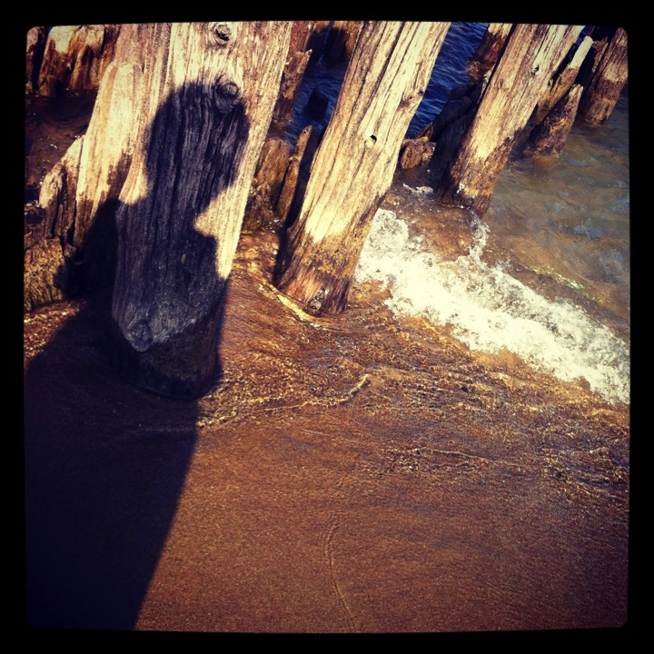
Answer
me when
I call.

Slide 20
You are my
strength
from morning ‘til night.

Slide 21
Lead me,
O God.

Slide 22
Make
a way
out of
no way.

Slide 23
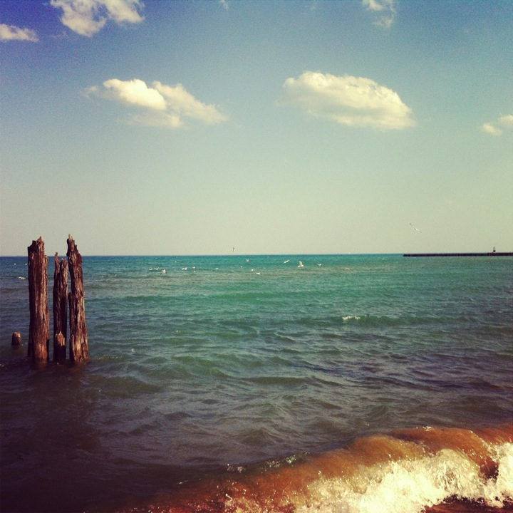
Listen to your
people.

Slide 24
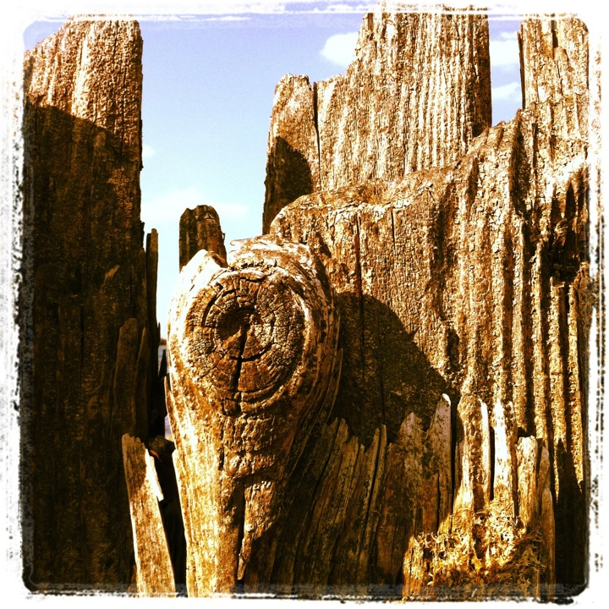
You
are
our
strength
and
our
redeemer.

Slide 25
With
you
at my
side,
how can
I be
afraid?

Slide 26
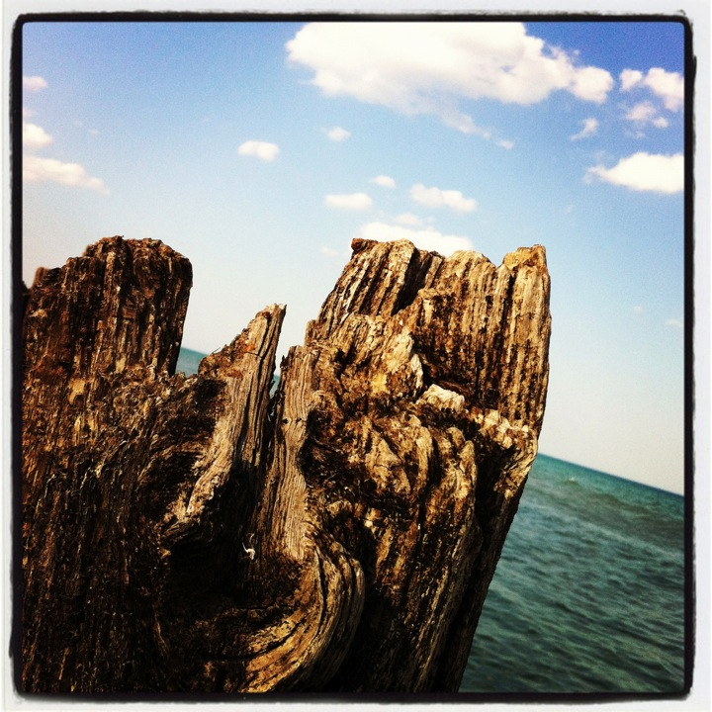
In and
through
all things
you guide
me.

Slide 27
Creation is so big,
and we are so small.

Slide 28
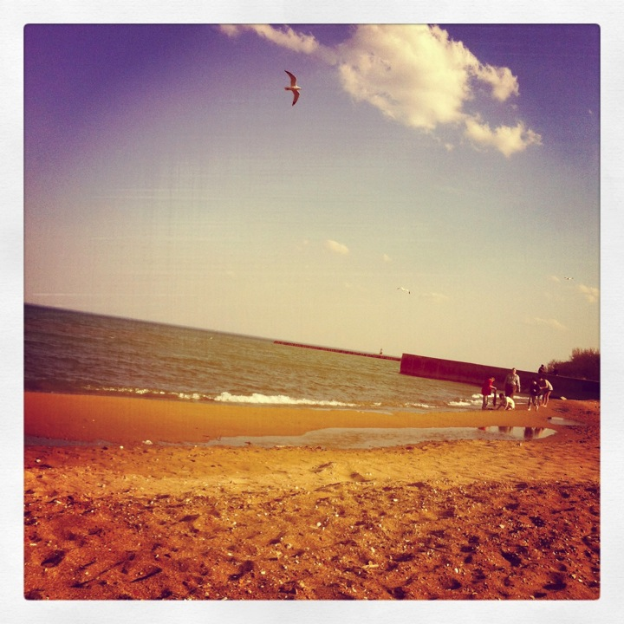
But we are inside it.

Slide 29
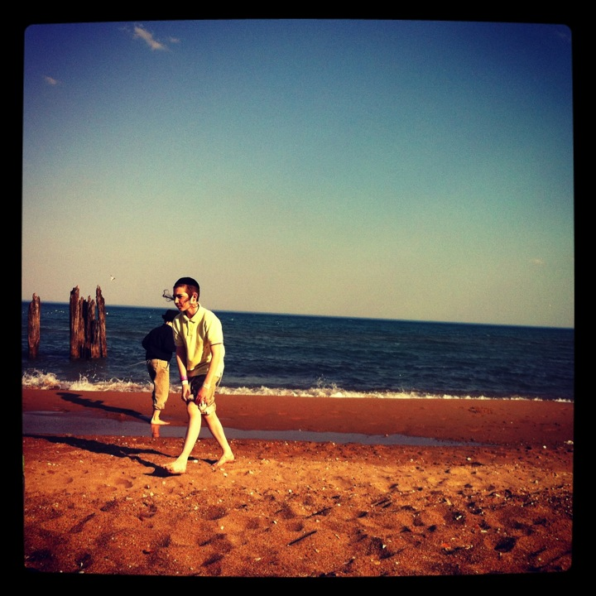
All of
us are.

Slide 30
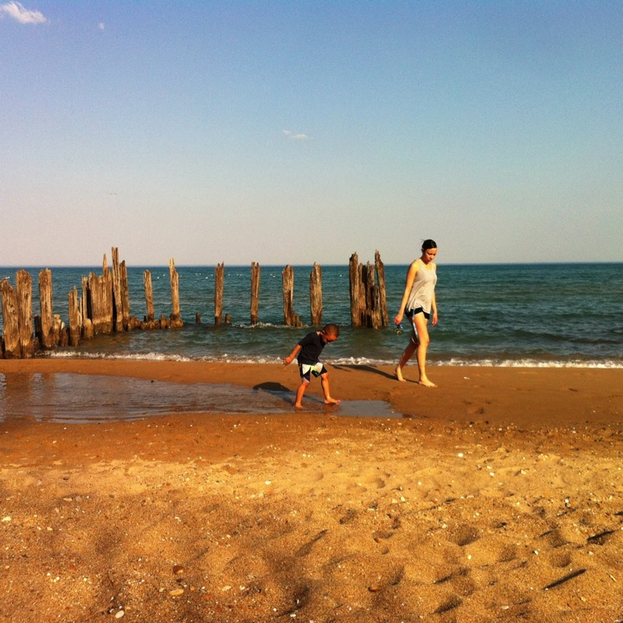
All of us.

Slide 31
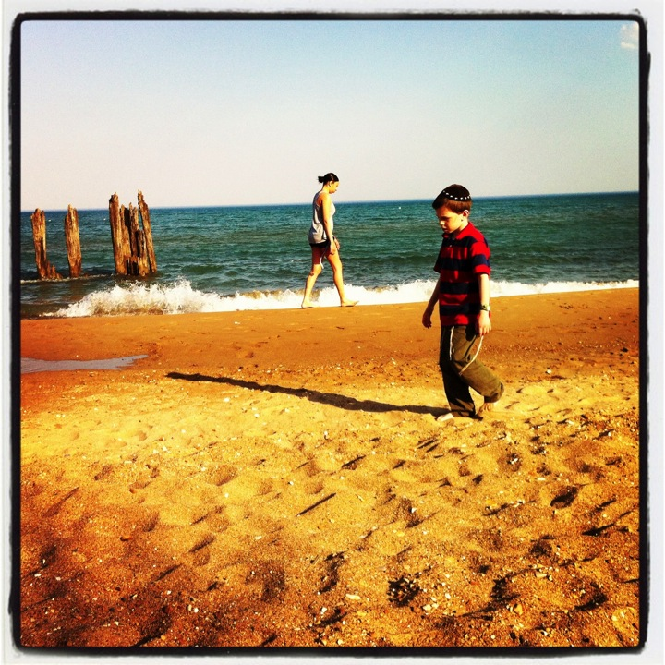
All of us.

Slide 32
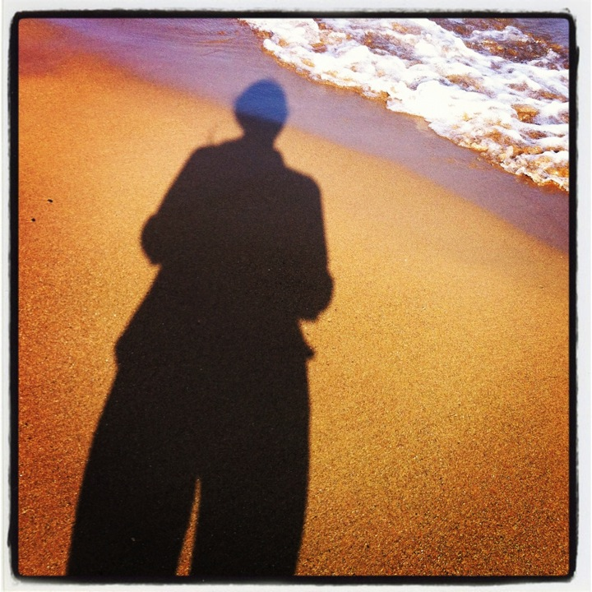
You
have
heard
the
prayers
of your
people
O God.

Slide 33
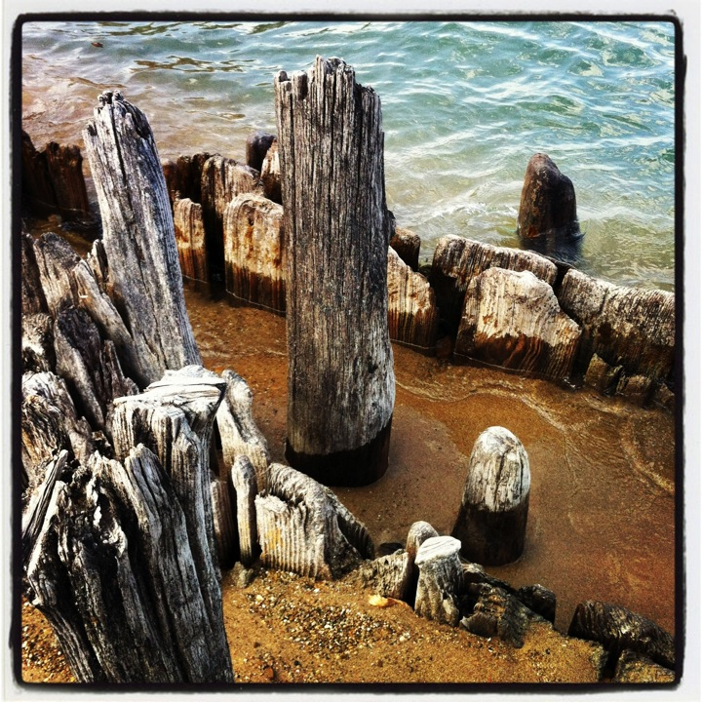
May your
steadfast love
endure forever.

Slide 34
May your steadfast love
endure forever.

Slide 35
May your steadfast love
endure forever.

Slide 36
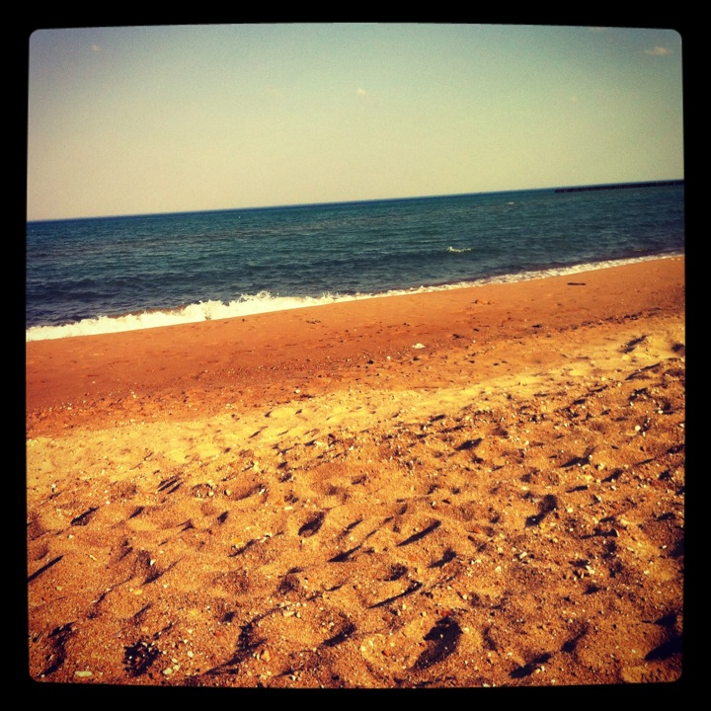
Amen
and

Slide 37
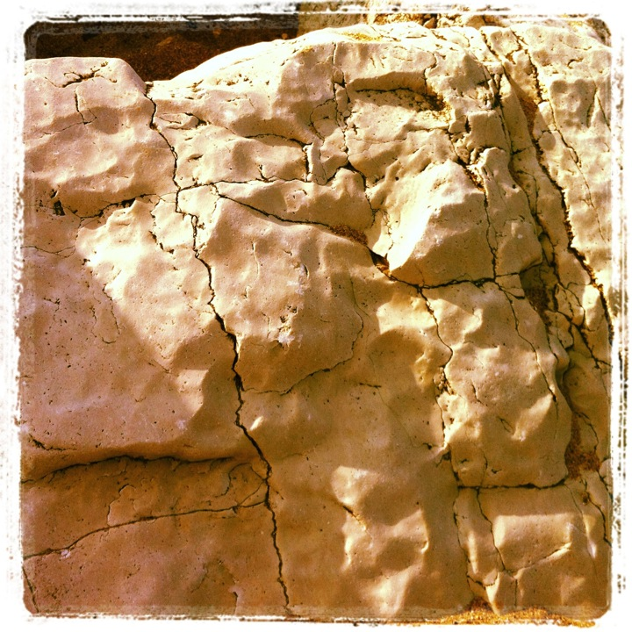
Amen
and

Slide 38
Amen.

